Slide 1

Oracle Hospitality Hotel Mobile Playbook
Hotel Solutions Management
Hospitality Global Business Unit
Version 1.4
August 2019

Slide 3
Hotel Mobile Playbook Contents
1
Introduction
Mobility
Key Benefits Hotel Mobile
Competition
Useful information
2
3
4
5

Slide 4
Hotel Mobile is the staff-facing app that provides the freedom of mobility to all Oracle Hospitality customers:
OPERA and Suite8

Slide 5
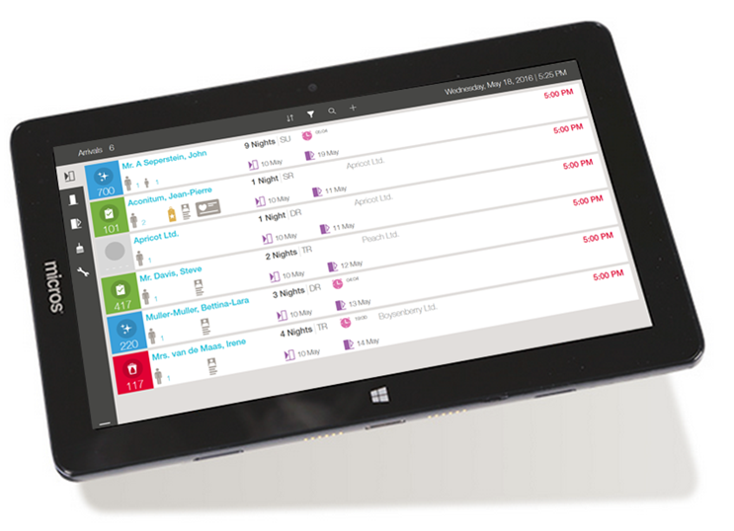
Introduction Hotel Mobile
Staff-facing native app for Windows (tablet devices), iOS (iPhone/iPod/iPad) and Android (phone)
Main capabilities:
  Phone / iPod: Housekeeping, Maintenance, Charge It
  Tablet : Arrivals, Departures (see slide 11 & 12), Housekeeping, Maintenance.
Native app for OPERA 5 and Suite8
Streamline housekeeping and maintenance operations
Real-time updates to PMS
*OPERA Cloud and OPERA Property v5 Cloud Service are pending
Keys
C&P
4111

Slide 6






Hotel Mobile – one for All
Data caching to view information
during brief wireless interruptions
Bring your own device (BYOD)
Fast and easy navigation
Hotel Mobile
Public (4G) or private network accessible
REST API
Shared Security Domain
(SSD)
REST API
OWS
OWS
XML Interface
OPERA 5 Property
Cloud Service
OPERA 5 Property
On-premise
Suite8

Slide 7







Benefits of Hotel Mobile
Deliver Exceptional Guest Experience
Improve Operational Efficiencies
Reduce Labor Costs
Engage with your guest anywhere
Intuitive UI for fast training (build-in Tutorial)
Native Windows & iOS App

Slide 8

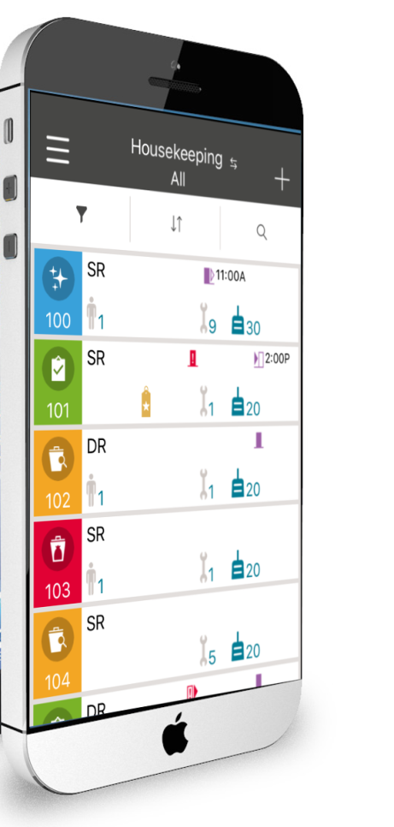
The Mobility Imperative
Mobile is here and is happening now
  39% of millennials have already ordered delivery or takeaway food via mobile device
  20% have already checked in to a hotel using a mobile device
Hotels need to deliver individualized mobile-powered guest experiences
Hotels wish to improve efficiencies and reduce costs in departments such housekeeping and maintenance
Hotels need to enhance collaboration within and across departments

Slide 9
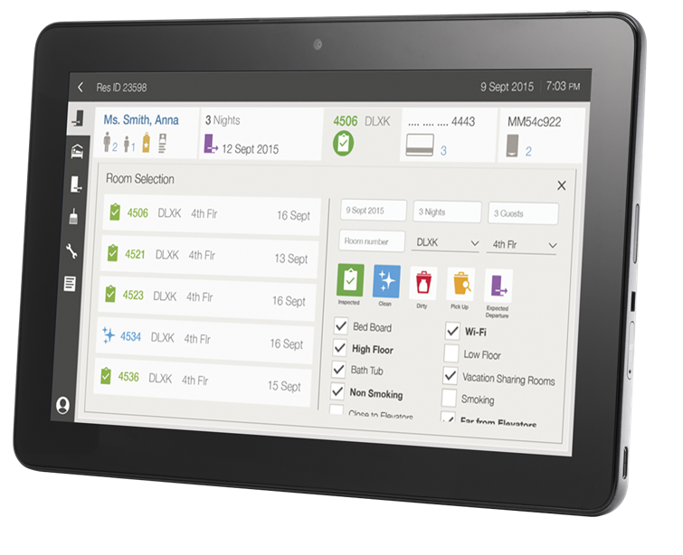
Why Now?
Guests expect mobile experiences
Associates can be more productive and deliver personalized experiences with mobile devices
Hotels Business needs to
embrace mobility to differentiate the guest experience and enhance operating efficiency

Slide 10


Meet Hotel Mobile
Housekeeping
Check-out
Maintenance
Check-in
Charge It

Slide 11
Hotel Mobile features
On Windows and iPad tablets
Check-in
Reservation Search
View reservation comments
Search and assign room
Supports accompanying guests & sharers
Manage guest profile & preferences
View/Print/Sign registration card
Add reservation to queue
Cancel reservation
Create room key (see limitations)
Capture credit card (see limitations)
Check-out
Post charges / articles
Move charges between windows
View/Email/Print folio
Check out
Create new billing Windows
Change email address
Add new credit card
Notes:
IOS APP available in iTunes app store

Slide 12
Hotel Mobile features
On Windows and iPad tablets
Housekeeping
List rooms with filters
View reservation info
Update housekeeping status (dirty, clean, etc.)
Update front desk status (occupied, vacant)
Queue room indicator and wait time
VIP and Loyalty indicators
Show my rooms
Linen & towel change indicator
Minibar article posting
Maintenance
View and create maintenance requests
Resolve requests
Add maintenance picture
Update comments
Enhanced maintenance tasks
Notes:
IOS APP available in iTunes app store

Slide 13
Hotel Mobile features
On iOS and Android phones
Housekeeping
List rooms with filters
View reservation info
Update housekeeping status (dirty, clean, etc.)
Update front desk status (occupied, vacant)
Queue room indicator and wait time
VIP and Loyalty indicators
Show my rooms
Linen & towel change indicator
Minibar article posting
Maintenance
View and create maintenance requests
Resolve requests
Add maintenance picture
Update comments
Enhanced maintenance tasks
Notes:
Available in respective app store.

Slide 14
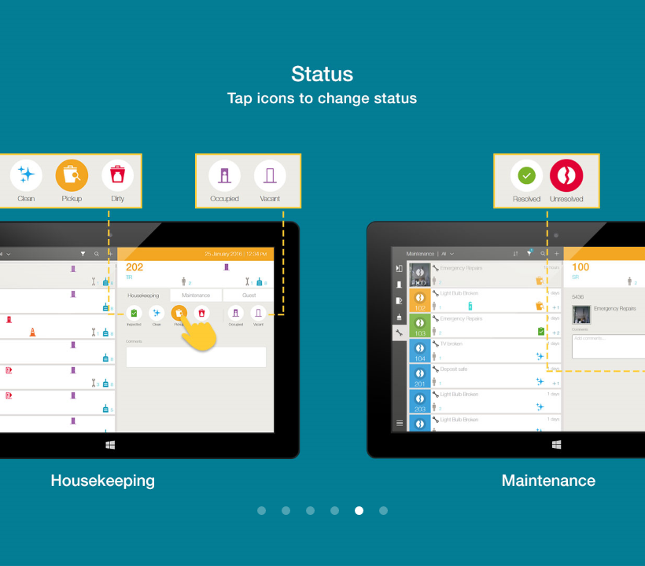
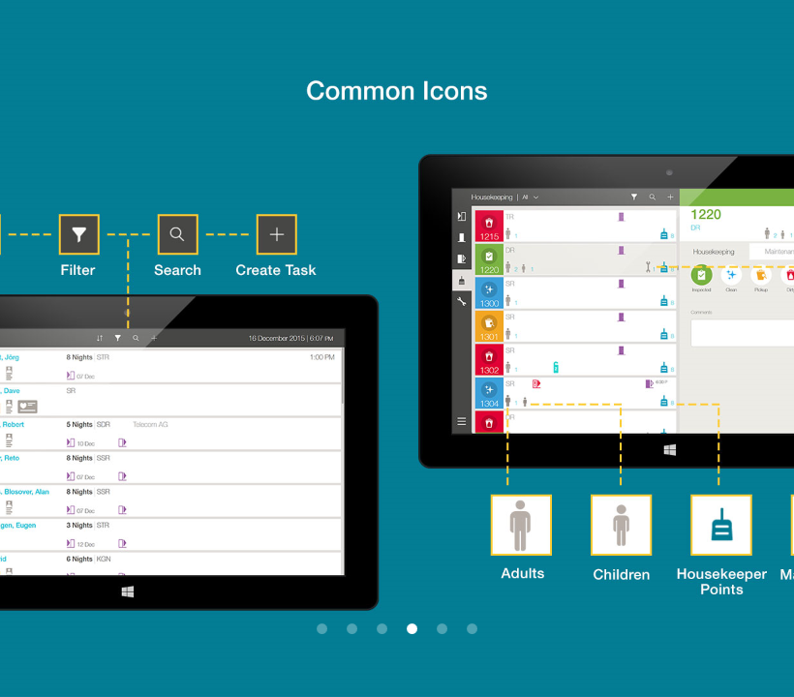
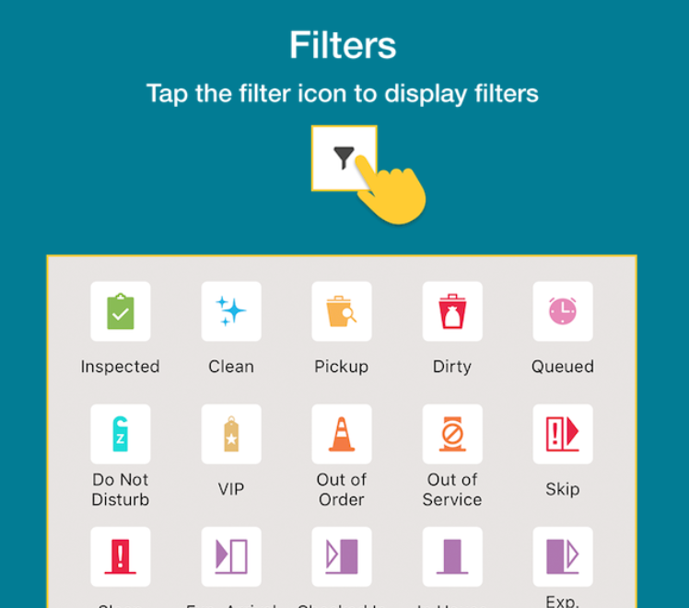
Hotel Mobile Tutorial – built-in Self-Learning
Tablet Tutorial how to change the Housekeeping and Maintenance Status
Tablet Tutorial outlining the common Icons used in the App
iOS Tutorial showing the different filter icons

Slide 15







Competitors
A few facts:
Seperate configuration, mapping tables
Seperate User Management
Seperate User rights/permissions
Not 100% integrated with OPERA / Suite8
Not 100% real time
Seperate installation & Support team
Seperate Contrat & increase of cost

Slide 16
Competitors:
Competitor | Product | Region | Comments | OPERA IFC | Suite8 IFC
StayNTouch | Rover | Global | Employee facing App Main competitor | OWS & Kiosk | No
Paragon | Hotsoft eXMI | EMEA | Support complete guest journey from booking to checkout | No | No
Optii Solutions | Optii Keeper | Global | Mobile housekeeping | HTNG IFC | No
KnowCross | Know Housekeeping |  | aka Triton; mobile Housekeeping operations | HTNG IFC | No
FCS | e-Housekeeping |  | Mobile Housekeeping | HTNG IFC | No
Amadeus | HotSOS / Rex | Global | Housekeeping & Maintenance | HTNG IFC | No
IJWS | iPad Check In-Out | Global | Check-In Check-Out | OWS & Kiosk | No

Slide 17



Hotel Mobile on premise solutions
Subject | Additional Information |  | Part No
OPERA Hotel Mobile | Oracle Hospitality OPERA Hotel Mobile (OPERA Property v5 on-premise) 15.00 US$ per room / 3.30 US$ support per year |  | L104989
Suite8 Hotel Mobile | Oracle Hospitality Suite8 Hotel Mobile 15.00 US$ per room / 3.30 US$ support per year |  | L104988
Windows App | Download from edelivery.oracle.com
iOS App | Download from Apple App Store
Android App | Download from Google Play Store
OPERA 5 Version Suite8 Version | 5.6.1+ / 5.5.0.21+ / 5.5.1.7+ 8.13+
REST API | An external SSL certificate from a trusted certification authority with a FQDN needs to be installed on the REST API server

Slide 18
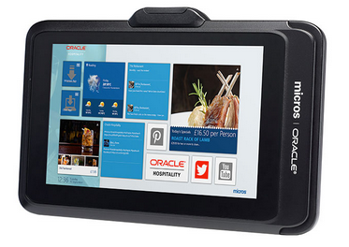
Hotel Mobile Solutions – Hardware
Subject | Additional Information | Part No
Oracle Tablets | Oracle MICROS 721 Tablet | 7118412
For more information, please visit the Global Hardware Pricelist available on eSource
Subject | Additional Information
Apple iOS | iOS version 11 or later iPhone 5S or higher, iPod Touch 5th generation or higher, iPad 5th generation or higher, iPad Air, iPad Pro
Android | Android 7 (Nougat) and above
Windows tablets | Generally available Microsoft Windows 8.1 or 10 tablets (8-inch & 11-inch)

Slide 19
Hotel Mobile Solutions – Hardware
OPERA OWS
Windows Server OWS, OAP, REST API Server Sizing | Sizing
OEDS Server running Hotel Mobile and component REST services, (150 rooms / 2 active mobile users) | CPU Memory Drive Count x size | 1 x Quad Core 12 GB 1 x 80 GB
Estimating Hotel Mobile requirements beyond standard OEDS Server requirements. It is estimated that active mobile users will generate ~3000 OEDS
requests/hour in a 150 room hotel environment. Hotel Mobile REST layer requires additional 2 GB memory. Minimum CPU requirements will be sufficient for associated load.
For more information, please visit the Oracle Help Center
Suite8 XML
Client Type | Win7 | Windows Server OS | Win 8.1 / Win 10
CPU | 1 | 1 | 1
Memory | 3GB (x86) 6GB (x86_64) | 4GB (x86) 6GB (x86_64) | 3GB (x86) 6GB (x86_64)
HD Free Space | >50GB | >50GB | >50GB
For more information, please visit the Oracle Help Center

Slide 20





Device support matrix
Devices
OS versions
Tablet functionality
Smartphone functionality
Windows
Any tablet with full version of Windows (not Windows RT)
8.1 and 10
Only Pro versions are supported
Check-in and Check out
In House
Maintenance
Housekeeping
Dashboard
Charge It
None, as no smartphone exists with full Windows version
iOS
iPhone 5s and above
iPod Touch 5th generation or higher
iPad 5th generation or higher
iPad Air
iPad Pro
iOS 11 and above
Check-in and Check out
In House
Maintenance
Housekeeping
Dashboard
Charge It
Housekeeping
Maintenance
Charge It
Android
Any Android device
Android 7 (Nougat) and above
Housekeeping
Maintenance
Charge It
Housekeeping
Maintenance
Charge It

Slide 21


Supported Capabilities
    Supports remote EMV PED selection for
      Payment type update at check-in
      Settlement on departure
      Based on IFC8
      Remote RFID Keycard Encoding
      Select nearest encoder
      Select number of keys
      Based on IFC8
    Registration Card
      Print wireless from tablet to wireless printer
      eSignature option available
      Folio
      Print from tablet to wireless printer
      Ability to email folio
      (requires email configuration in the PMS)
C&P
4111
Keys
Notes:
Payment requires OPI compatible version of OPERA; payment provider communicates with EMV PED.

Slide 22
MOBILE RFID Key Encoding
With OS-specific software/app installed and a RFID encoder connected to tablet mobile RFID key encoding is possible. Ask the property to contact their key vendor to confirm OS, software and hardware requirements.
ASSA ABLOY HOSPITALITY (VINGCARD)
Vingcard client software is installed on WINDOWS tablet to communicate with encoder. Hotel Mobile displays this encoder as an available network (remote) encoder.
Requires the property to upgrade to VISIONLINE - http://www.assaabloyhospitality.com/en/aah/com/products/system-and-software/visionline/
A USB-connected RFID encoder available for WINDOWS tablets - https://www.hidglobal.com/products/readers/omnikey/5022-smart-card-reader
Vingcard client software is installed on WINDOWS tablet and HOTEL MOBILE displays this encoder as an available network (remote) encoder.

Slide 23

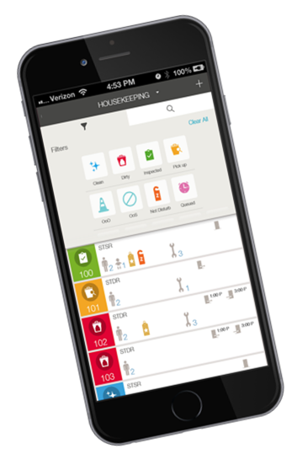

Oracle Hospitality Hotel Mobile
Marketing Information

