Slide 1
Basic OXI
Kristina Berndt
Customer Support Analyst 2
(Central Systems L2)
Columbia, MD, USA
Copyright © 2019 Oracle and/or its affiliates.

Slide 3
What’s Ahead
Basic OXI - Monday or Wednesday
Advanced OXI - Tuesday or Thursday
10:00-12:00
12:00-1:00
1:00-2:00
3:00 – 6:00
WHAT IS OXI
Reading XML Files
Finding OXI Logs
Finding Errors in OPERA & OXI processor logs
Performing resyncs and their differences
Checking conversion codes ad interface defaults
Checking SSL Certificates
OWS: ASMX pages and restarting services via batch files
WHOLE GROUP TROUBLESHOOTING OF SRS WITH PMS AGENTS
LUNCH
1 ON 1 TROUBLESHOOTING OF SRS ON THE FLOOR WITH PMS AGENTS
10:00-12:00
12:00-1:00
1:00-2:00
3:00 – 6:00
OXI FOR CENTRAL SYSTEMS
Tools for testing credentials posting through SOAP UI, mfhttp, and Firefox add on
Learn GSIM/SOAP UI for OWS
Using GTEST for GDS
WHOLE GROUP TROUBLESHOOTING OF SRS WITH OXI AGENTS
LUNCH
1 ON 1 TROUBLESHOOTING OF SRS ON THE WITH OXI AGENTS

Slide 4
Our Goal
To learn how to troubleshoot and close open OXI SRs.

Slide 5
Basic OXI

Slide 6
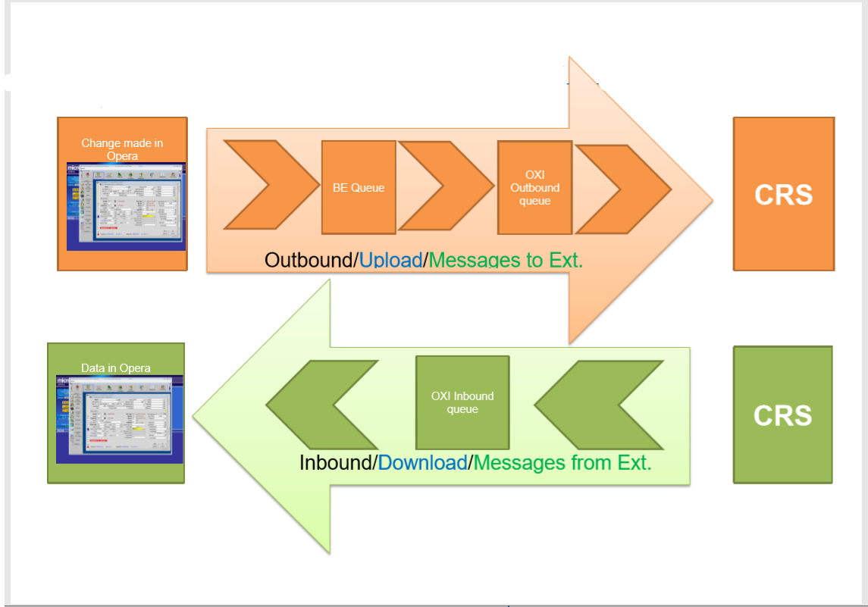
OXI Overview

Slide 7
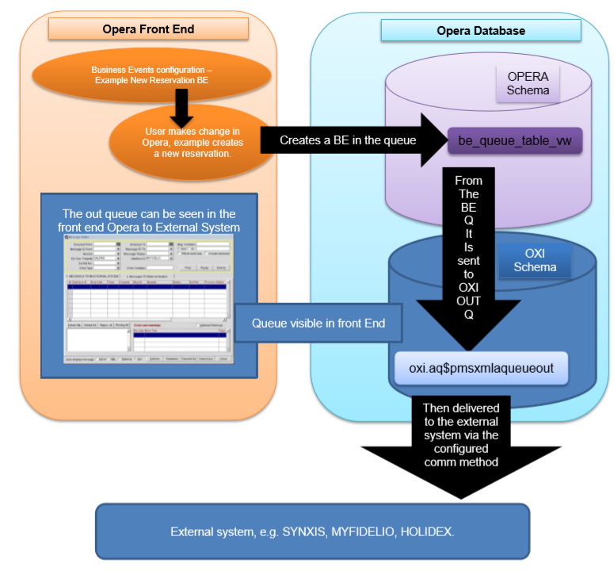
OXI Schematics – Messages to External System

Slide 8
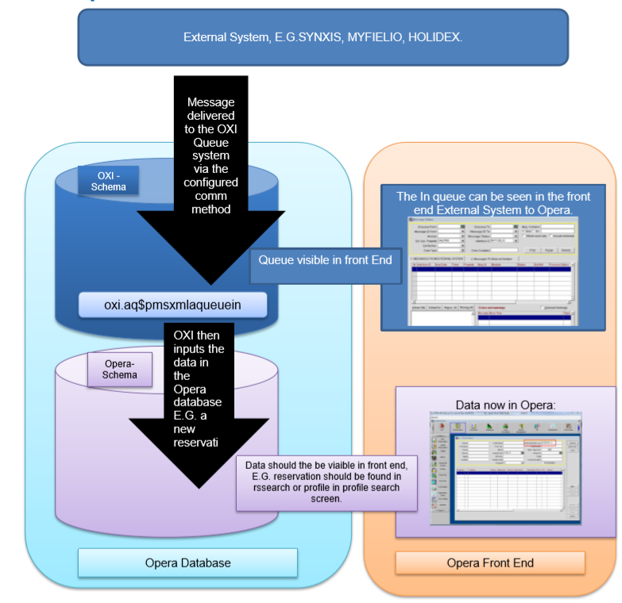
OXI Schematic – External System to Opera

Slide 9
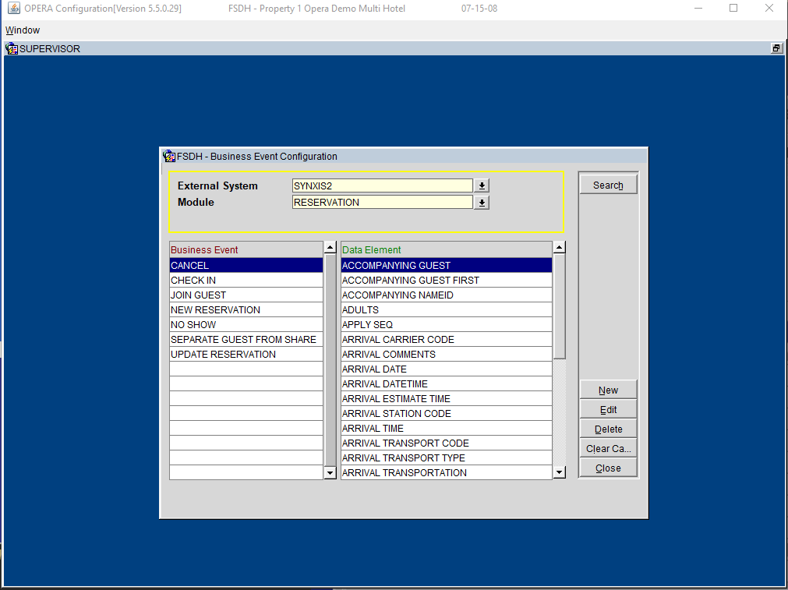
Business Events
Business Events are required in Opera to send messages to an external system. What exact business events you need to configure depends entirely on the nature of the interface
Configuration > setup > Business Events > Configuration
Opera translate business events into messages to the vendor such as XML messages. For oxi the messages can be found in OXI > interface status > message status > messages to external.
*Please note that most OXI interfaces will use ATS (Automatic Transmission Schedule) for Blocks

Slide 10
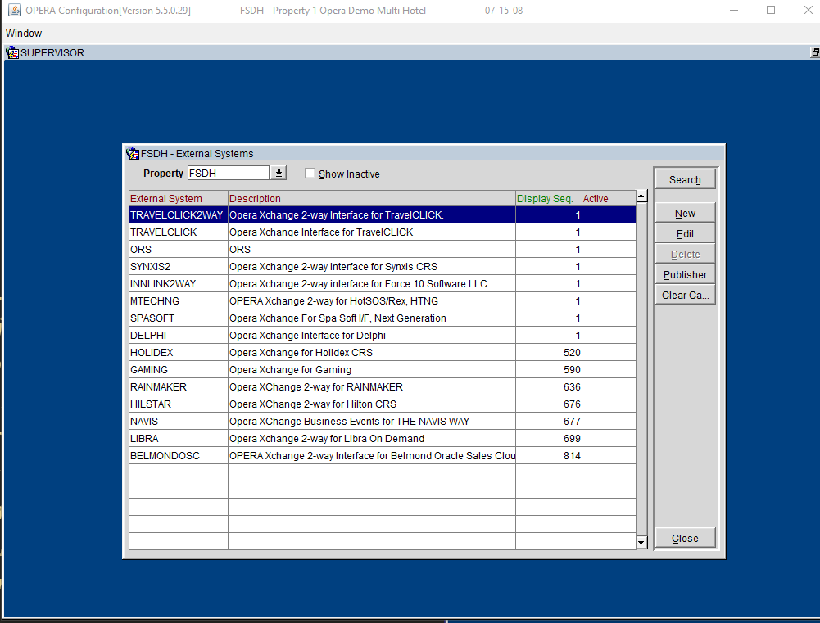
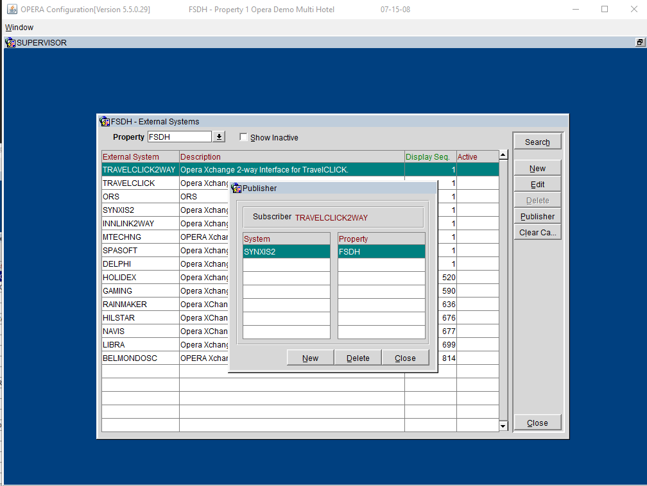
External Systems: Publisher Subscriber
Doc ID 2159526.1
This area is designed to identify the desire for an External System to receive messages originating from another External System. In order to receive messages for events that originate outside OPERA PMS, this relationship must be established.
Configuration > Setup > Business Events > External Systems

Slide 11
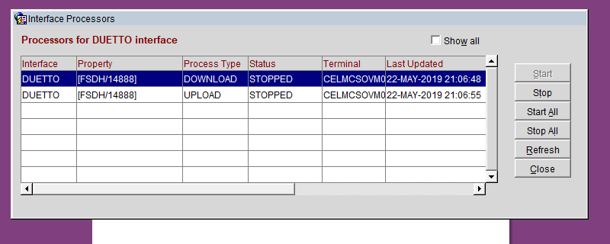
How/where to find check if
processors are running
(Doc ID 2211614.1)
Oxi > interface status> start/ stop process
(Doc ID 2211631.1)
Terminal Name is where the oxi server is located

Slide 12
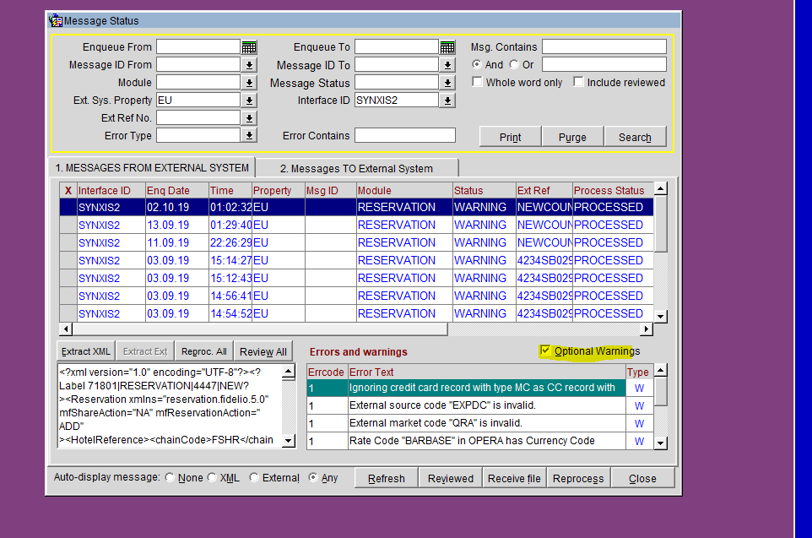
How/where to find errors in OPERA & OXI processor logs
(Doc ID 2182660.1)
Oxi > interface status > message status > search > also ensure optional warnings is checked.

Slide 13
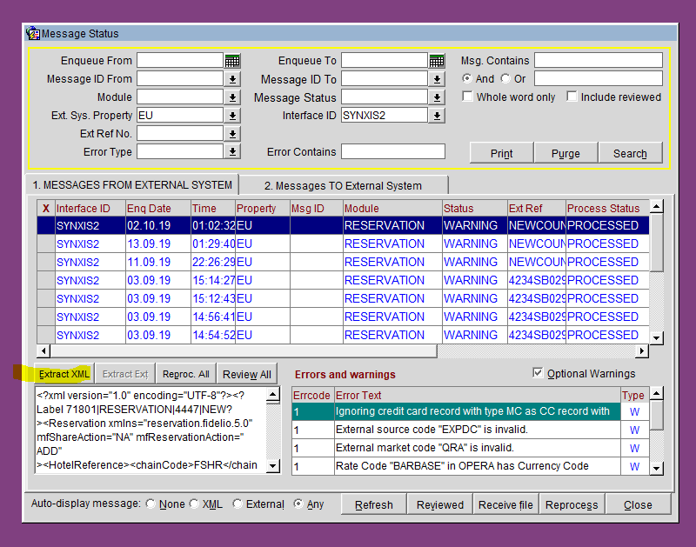
OXI XML Messages
(Doc ID 2184150.1)
Extract XML will open up the file

Slide 14
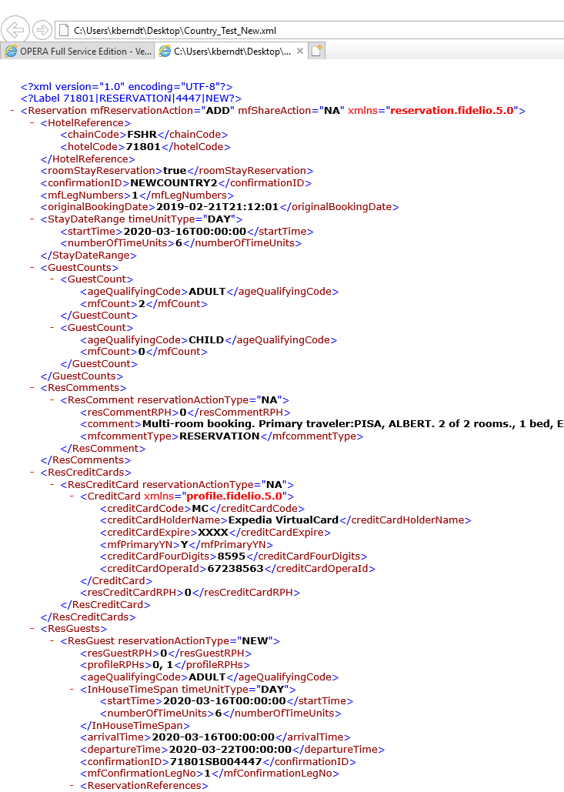
XML Code

Slide 15
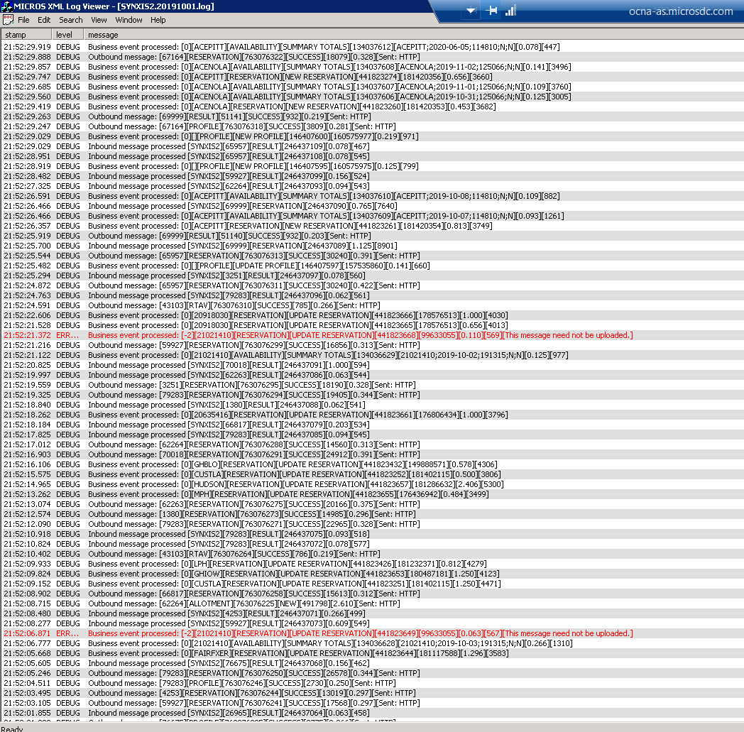

OXI Processor Logs
Can be found on OXI server by looking for this icon on the desktop
Example of Logs
Logs will look like this.
Messages in Red are errors.

Slide 16
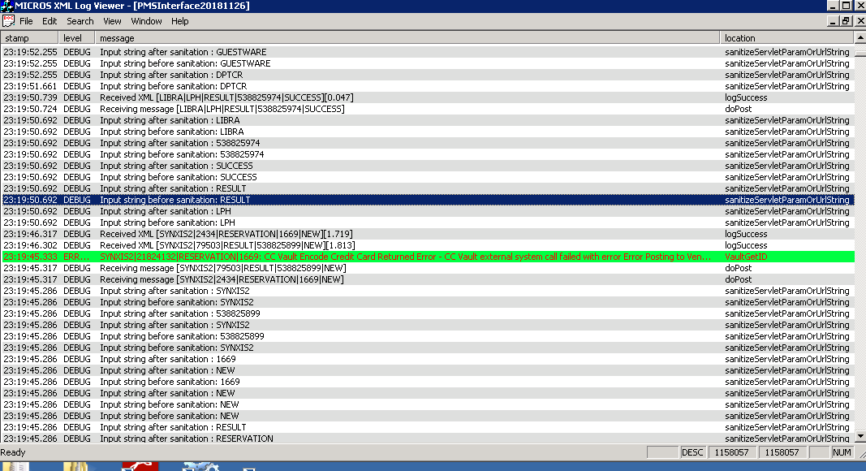
PMSInterfacelogs
Doc ID 2121562.1
PMSInterface Logs will show inbound messages along with any errors not found in OXI Processor logs. In large environments the OXI server usually has an application server installed and external system posts to the servlets on that server, however if you are unsure check with customer or external system support (Vendor/Partner) to confirm the server/URL they are posting to. Then also see if you can test this Servlet locally on the OXIServlet server to check for certificate errors. File Path: D:\MICROS\opera\operaias\webtemp

Slide 17
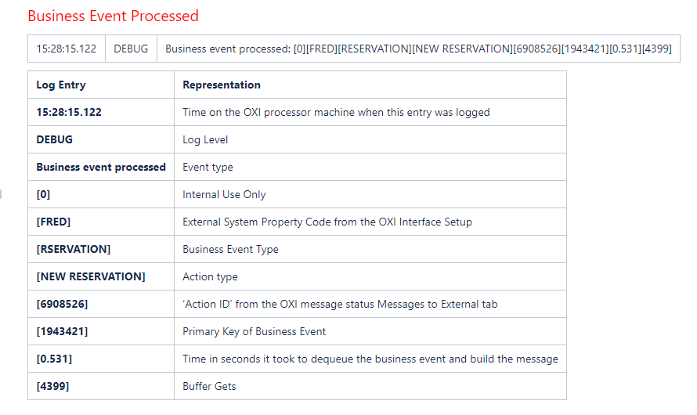
How to Understand OXI Processor Log Entries
Explanation of OXI Log Entries

Slide 18
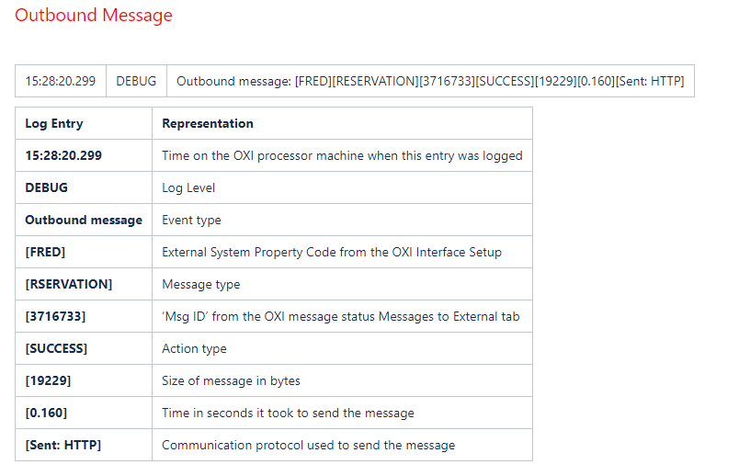
How to Understand OXI Processor Log Entries
Explanation of OXI Log Entries

Slide 19
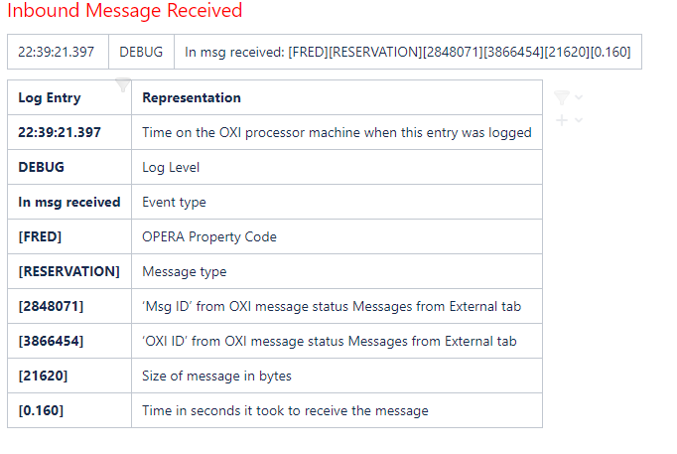
How to Understand OXI Processor Log Entries
Explanation of OXI Log Entries

Slide 20
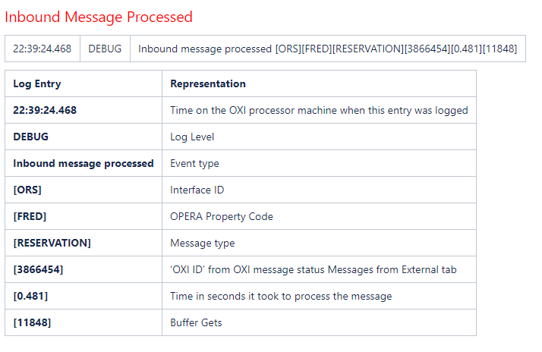
How to Understand OXI Processor Log Entries
Explanation of OXI Log Entries

Slide 21
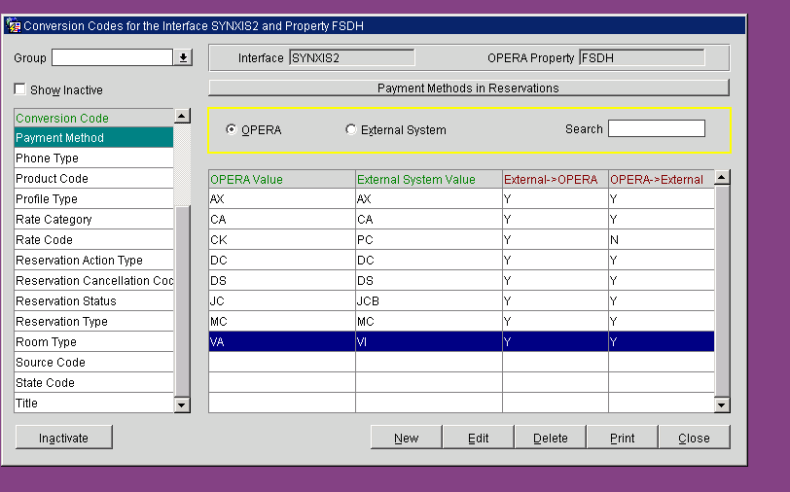
Conversion Codes & Interface Defaults
Doc ID 2533971.1
OXI > interface config > conversion codes
Conversion codes are used to map different elements such as room type, rate codes, and payment methods to external vendor. For example payment method VISA could be VA in opera and VI for external vendor. Hence conversion codes need to be used so when receiving/sending messages the correct code is used.

Slide 22
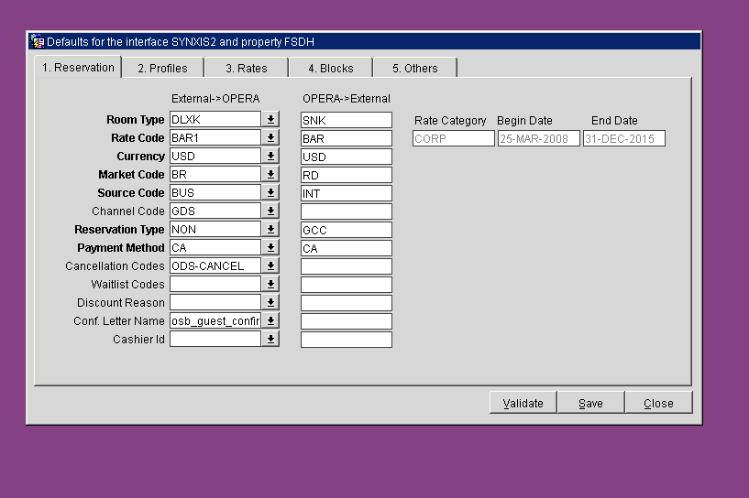
Interface Defaults
Doc ID 2150912.1
OXI > interface config > interface defaults
Interface defaults are used when sending/receiving an element from vendor that is not mapped or setup in Opera. The default element will be used instead rather that failing the message.

Slide 23
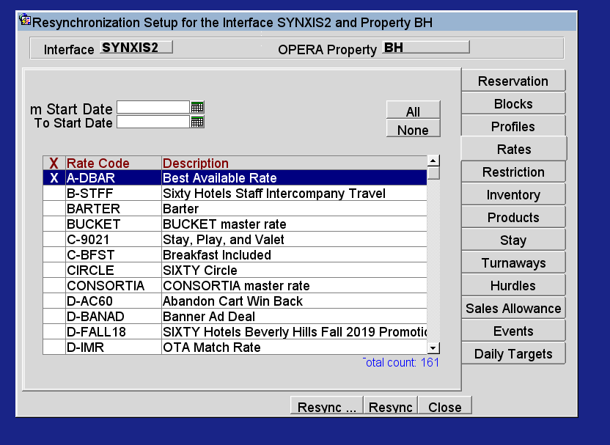
Resyncs
Doc ID 2301822.1
Resyncs can be used when information is not displaying correctly on Vendor side. Some resyncs are unique and certain things should be done and some should NOT be performed. The 5 main types of resyncs are Reservation, Rate, Restriction, Block & Inventory.
Block & Rate Resync
Please select Block & Rate in question by checking the X in column next to desired Rate/Block. Selecting all can generate an excessive amount of messages and create a backup/delay in messages.
1 of 2

Slide 24
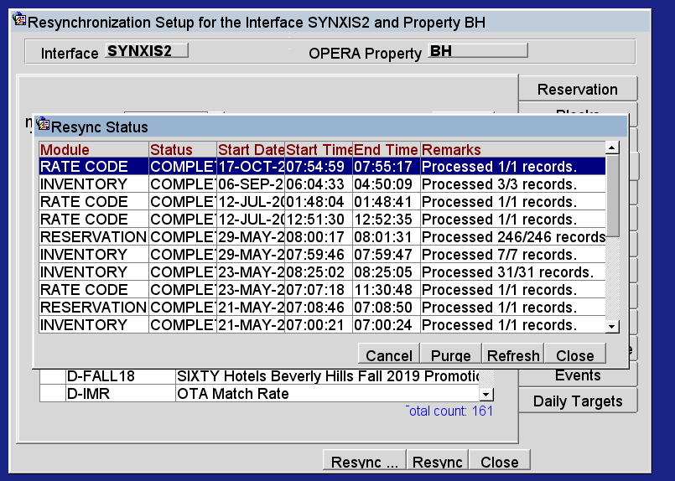
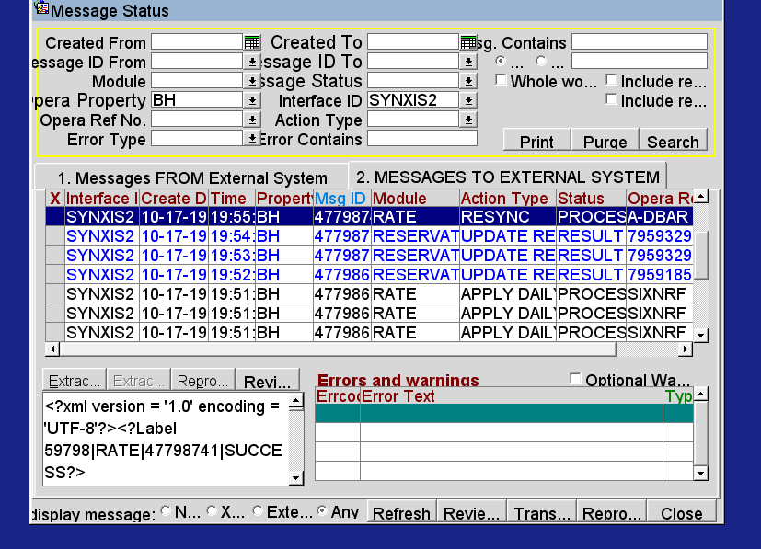
It will show number of records processed as shown below
Block & Rate Resync
Check messages in message status screen > messages to external to show whether it processed successfully or failed.
Rate Resync Doc ID 2419352.1

Slide 25
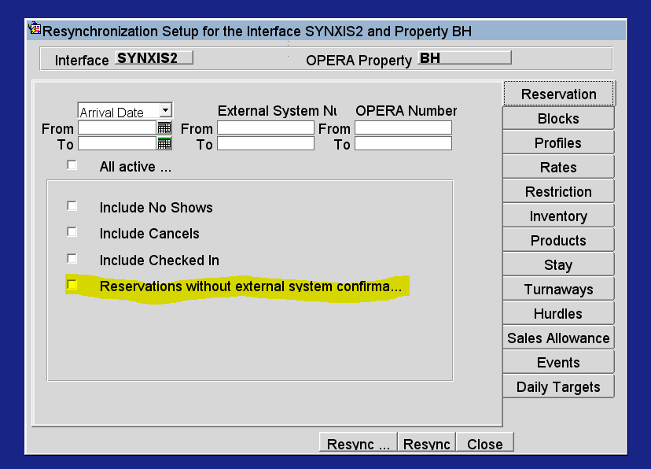
Reservation Resyncs
Should only be used when there is no CRS number from or vendor request certain dates. This should NOT be used for when reservations are not integrating for vendor. Most of the time we do this for no CRS numbers and the box “reservations w/ out CRS number only” should be checked.

Slide 26
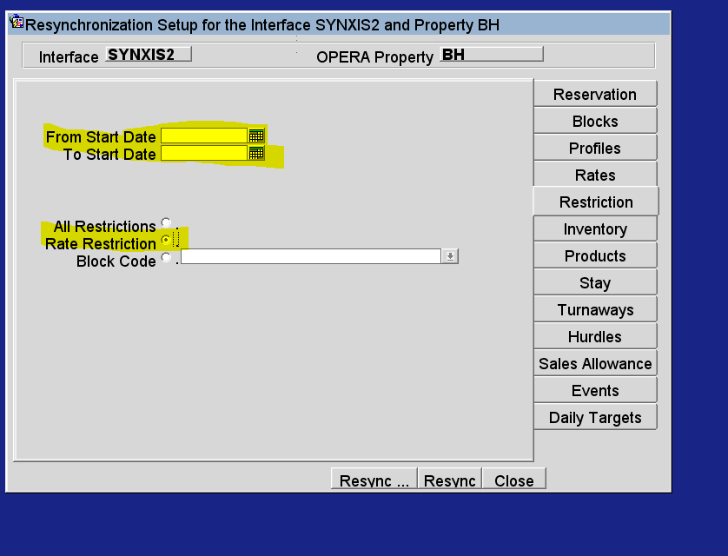
Rate Restriction Resyncs
Should be done for dates in question only & by rate. Selecting a large date range will create a lot of messages & cause backlog of messages.

Slide 27
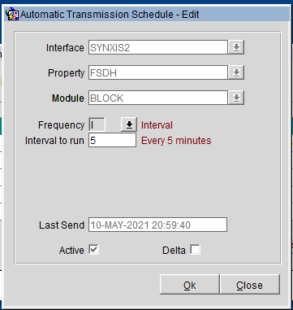
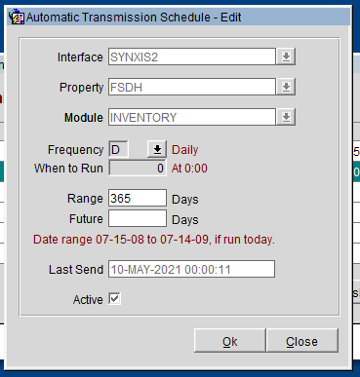
Automatic Transmission Schedule (ATS)
This utility allows the external system to receive data in pre-definable, regular intervals. Most common used it Blocks and Inventory
OXI > Interface Configuration > Automatic Transmission Schedule
Blocks
Inventory
Setup determined by install Doc

Slide 28
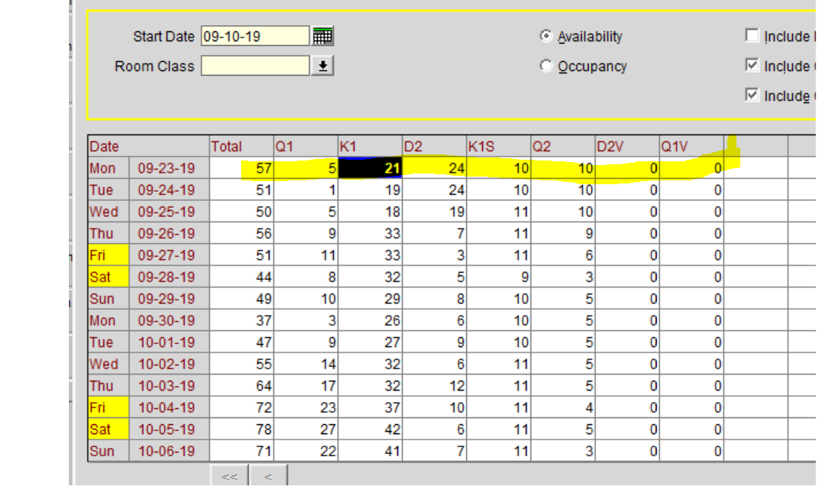
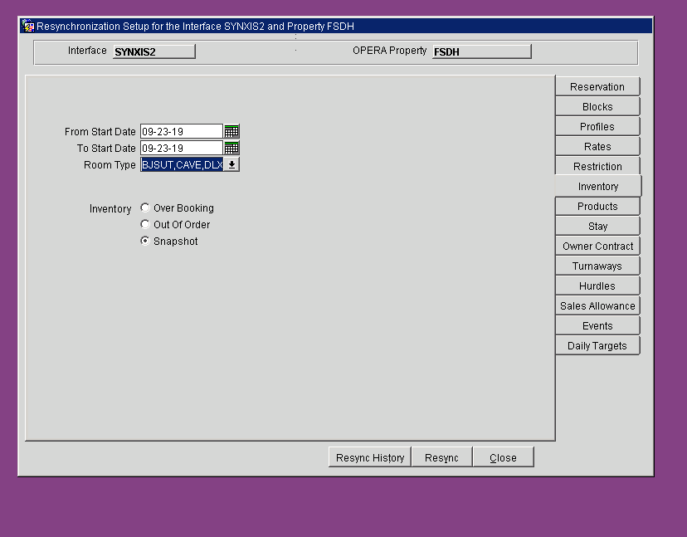
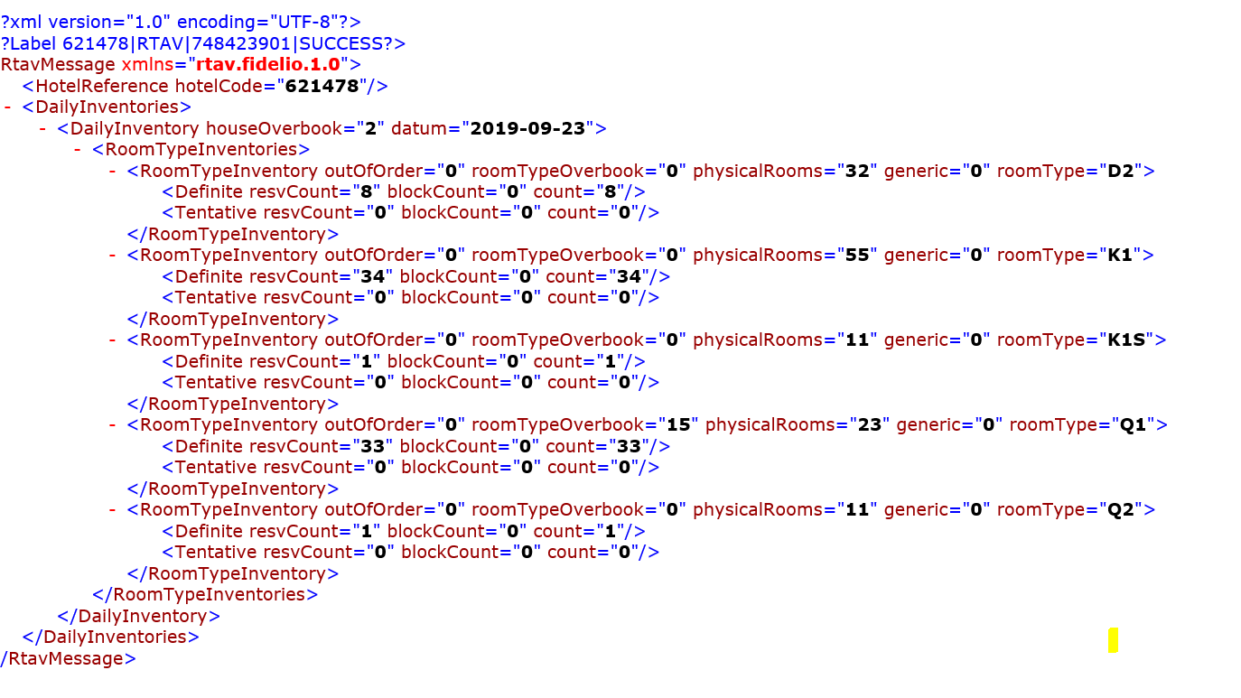
Inventory Resyncs
Should be used only for dates in questions & all room types. When Resyncing should do by snapshot only. In below example shows the inventory in opera and what is being sent to the vendor.
Doc ID 2419157.1

Slide 29
Messages not downloading/integrating – check list
1. Are the processors running? Doc ID 2211614.1
2. Does the OXI Servlet Load? 10g Doc ID 2335347.1 11g and higher Doc id 2256681.1
3. Is there enough tablespace? Doc ID 2122512.1
4. Is the SSL certificate current?
5. Are there errors in OXI or OXI Processor Logs? Doc ID 2182660.1 & Doc ID 2118134.1
6. Are there errors in PMSinterface Logs? Doc ID 2121562.1
7. Are there entries in access logs?

Slide 30
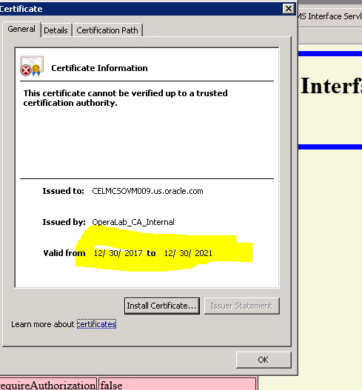
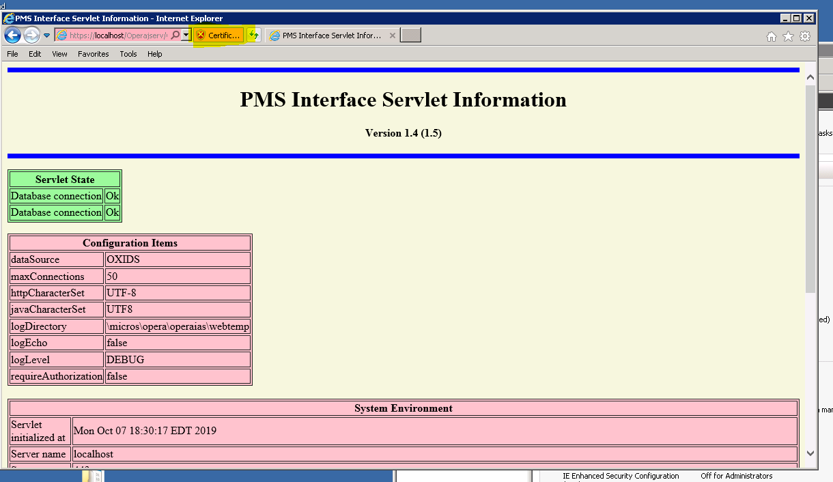
Basic Checks- Reservations not Integrating
Confirm able to load servlet
Most 11g 5.5 + sites use below for servlet
https://localhost/Operajserv/OXIServlets/PMSInterface?info=y
Check SSL cert (highlight above) that it is not expired

Slide 31
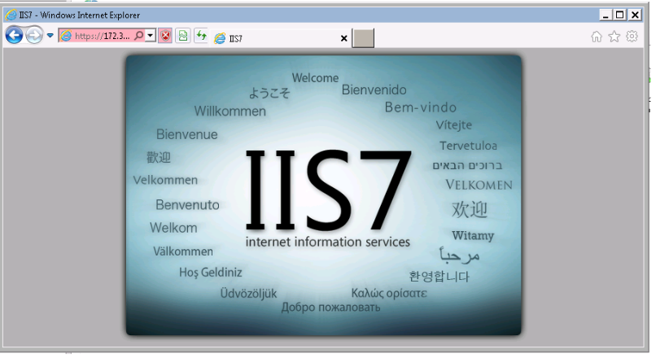
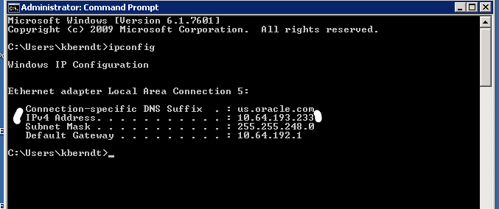
IIS Reverse Proxy – Checking OXI Servlets
Sites that are using reverse proxy (generally older versions of OPERA/10g) the below 3 URLs need to be checked. The first two will bring up servlet. The last will bring IIS page. All 3 need to load. See Doc 2335347.1
*please note you will need to check IIS logs for access attempts, instead of standard OHS/Apache logs for access attempts
http://localhost:8081/Operajserv/OXIServlets/PMSInterface?info=y
https://172.31.44.213/Operajserv/OXIServlets/PMSInterface?info=y
https:// 172.31.44.213 (server IP)
To find IP in command prompt type ‘ipconfig’

Slide 32
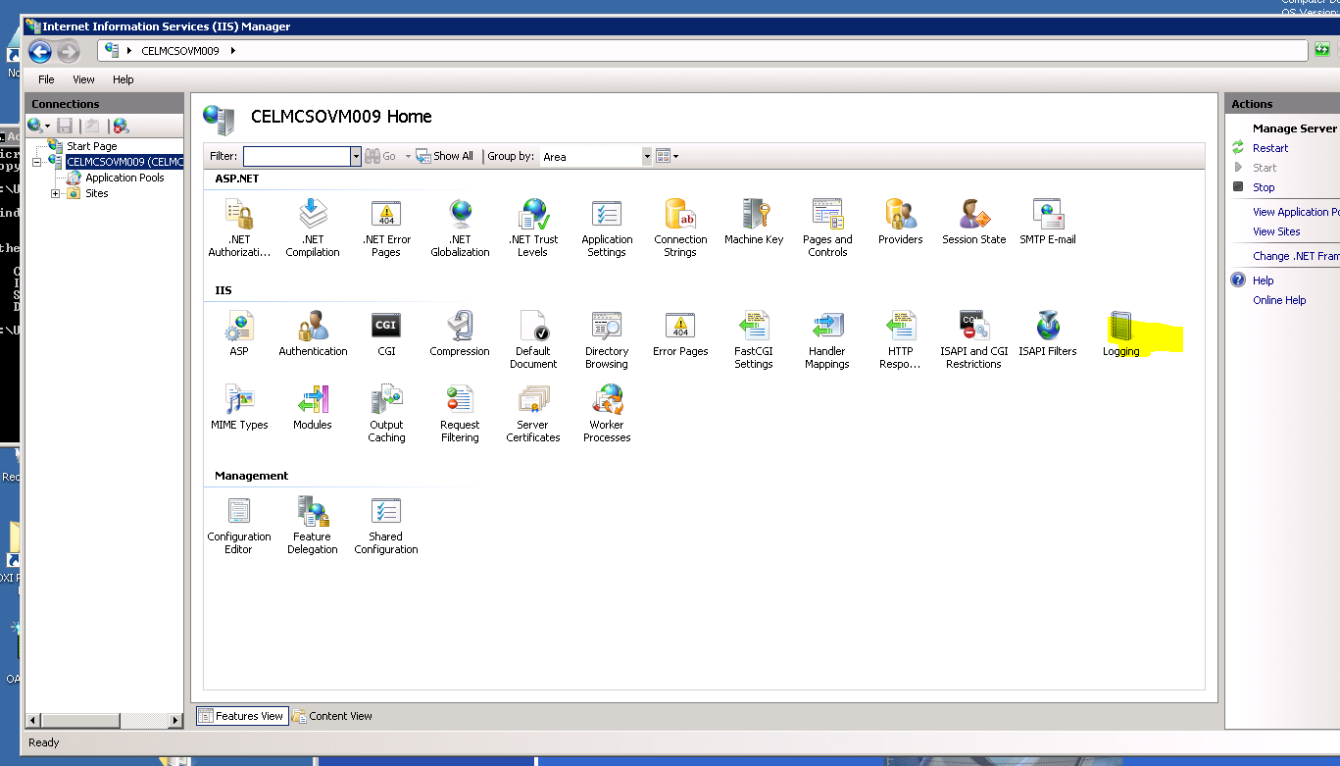
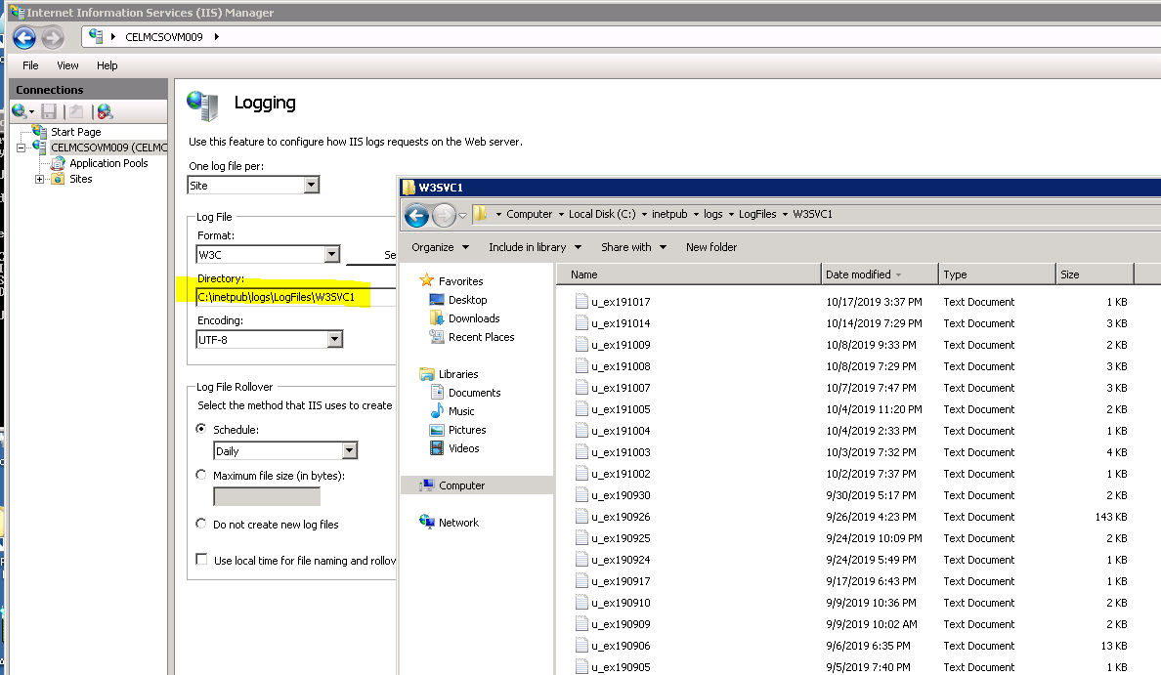
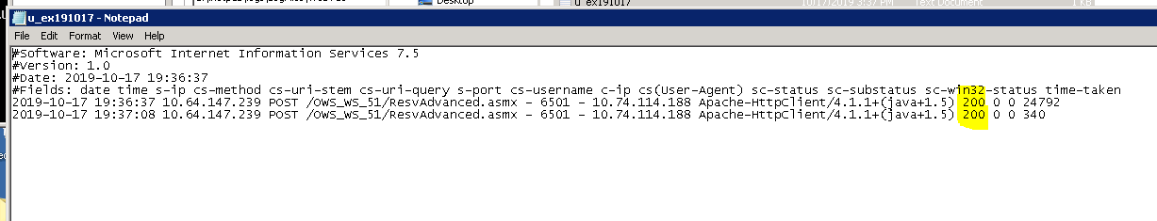
IIS Reverse Proxy – Checking IIS Logs
In IIS (short cut > run > inetmgr)
Clicking on logging will give you file path & you can navigate to the location and review recent logs. Same concept as access logs
*Checking IIS logs are used to check both reverse proxy and OWS attempts.

Slide 33
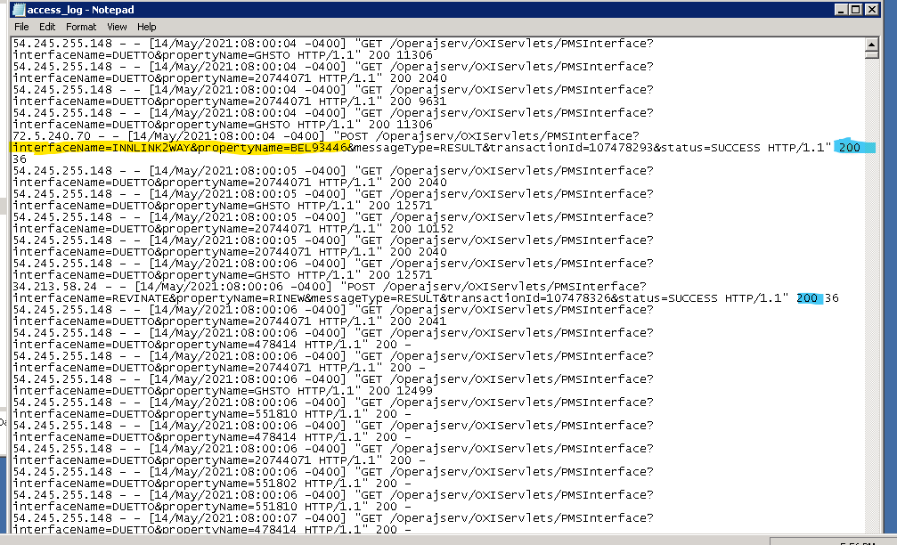
Checking Access Logs
Access logs can be found in following location for 11g sites.
D:\ORA\operainstance\diagnostics\logs\OHS\ohs1
You should see post attempts from vendor w/ 200 at the end.
Any other number is an error on our end such as 500/404
Older versions of opera & 10g sites.
Logs can be found in following location
D:\oracle\10gappr2\Apache\Apache\logs

Slide 34
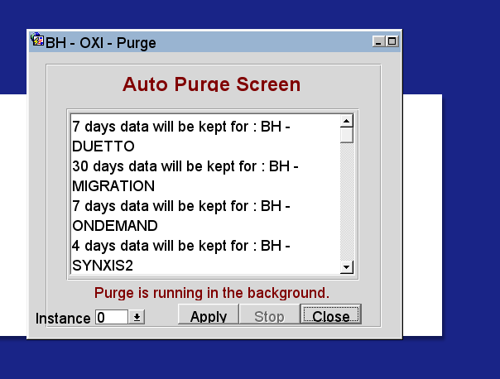
OXI Tablespace
Sometimes a site will generate a lot of messages and the tablespace will fill up causing reservations not to integrate. If tablespace is full you can either extend, or perform deques. If you are unsure please check with a senior tech. Another common issue is the Purge isn’t running or Purge days are too high. You can check the purge by going to below
OXI > utilities > purge
If purge is not running - Please start it. If you see messages for more than 7 days this can factor in as well.

Slide 35
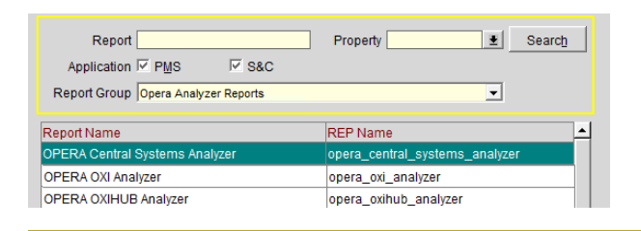
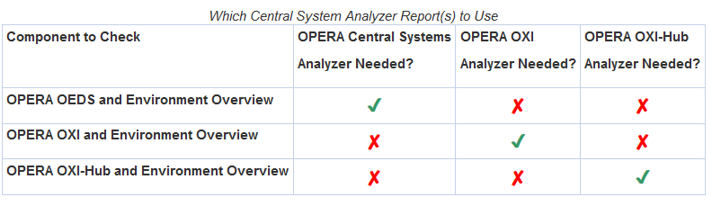
Health Check Analyzers
Doc ID 2591403.1
The three OPERA Central System Analyzer Reports provide an overview of the health and status of your environment's OPERA OXI, OXI-Hub and OEDS installations.
They are self-service OPERA Central System status reports which:
Can be run at any time
Analyze the environment's current status
Identify known issues
Provide solutions for known problems and best practice recommendations as appropriate.
The recommended action may vary depending whether the installation is on-premise.

Slide 36

Additional Resources
Below is link to most install docs for OEDS/OXI if you do not see what you are looking for then you can try the Sustaining Engineering confluence page.
If you're still stuck please run the Troubleshooting Steps through IT Flow and make sure the following files are attached.
Examples with Screenshots
Corresponding XML of Examples
PMSInterface Logs
OXI Processor Logs
Health Check Analyzers for Central Systems/OXI
HGBU OPERA OXI Install Docs
Sustaining Engineering (SE) Confluence Page
As OXI relies strongly on some functionality directly in Opera, see if the users can reproduce the scenario without involving OXI. For example, if they see an issue when a reservation is created from OXI, try to have the users create the same reservation in Opera directly with almost the same fields as the OXI reservation : If the issue is reproducible in Opera PMS directly, this is likely not an issue with OXI specifically

Slide 37
Thank You
Kristina Berndt
Customer Support Analyst 2
(Central Systems L2)
Columbia, MD, USA

